Slide 1
Documentum Fundamentals
Notes:
Place the audio notes for this slide here

Slide 2

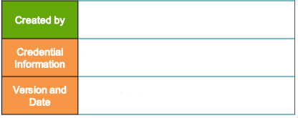
Hanisha Jivrajani (631636)
Enterprise Content Management Compétency
V 1.0, 7th February 2018

Slide 3
Agenda
Documentum Overview
Documentum Concepts
Library Function and Versioning
Applications for using and managing Documentum platform
Practice Lab

Slide 4
Documentum Overview

Slide 5
Documentum ECM Platform
Documentum is an enterprise content management platform, now owned by OpenText.
EMC acquired Documentum for $1.7 billion in December, 2003.
The Documentum platform was part of EMC's Enterprise Content Division (ECD) business unit, one of EMC's four operating divisions.
On September 12, 2016, OpenText, a Canadian technology firm based in Waterloo, Ontario, Canada that specializes in enterprise content management, announced a definitive agreement to acquire Documentum from Dell EMC for $1.6B USD.

Slide 6
Documentum ECM Platform
Latest version of Documentum as of today is 7.3 version.
Adds intelligence to content for fast searches.
Manages content lifecycles according to user –defined business rules.
Controls publishing of content through multiple channels and formats.
Controls access to documents based on security levels.
Enforces regulatory requirements.
Supports Collaboration.
Integrates with authoring tools and enterprise applications.

Slide 7
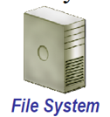

Managing ECM system Vs. File system
Advantages to managing documents in an ECM System versus File system
Can’t be certain that the document is latest version | Always access most up to date version of a document
Limited permission settings for individual documents | Restrict who can read, write, edit or delete a document
Search for documents based on a limited set of properties | Search on documents based on descriptive information
Different format maintained as separate files | Seamlessly maintain different formats of same document
Workflow and routing not available | Route documents for review and approval

Slide 8
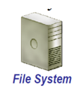

Distributed documents managed by ECM System Vs. File System
Advantages for distributing documents managed by ECM System versus File System
Reference documents via file system path that: Don’t necessarily reference the latest version Are invalid if the document is moved Sending a document as an attachment exacerbates version and security issues Increased disk space usage` | Reference documents via dynamic URLs that: Always retrieve correct version of a document Always retrieve the document even if changes location Restrict access to the document based on permission settings

Slide 9
Example of Enterprise content?
Forms Processing
Email
Web Content
Office Documents
All the above
Answer: e

Slide 10
Which of the following are Features of a ECM system (Documentum)
a) Search on documents based on descriptive information
b) Can maintain different formats of same document
c) Limited permission settings for individual documents
d) Workflow and routing not available
Answer: a and b

Slide 11
Summary
Documentum is an enterprise content management platform, currently owned by OpenText.
Latest version of Documentum as of today is 7.3 version.

Slide 12
Documentum Concepts

Slide 13
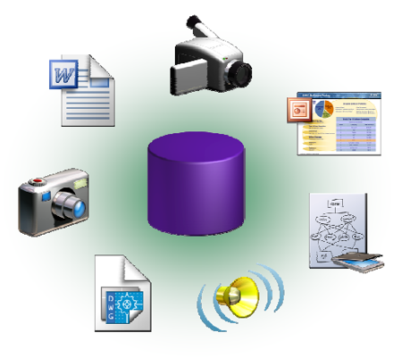
What is Content?
Any type of electronic data that can be managed by the repository:
Document
Web Page
XML document
Report
Executable
Engineering drawing
Scanned image
Audio or video file
Thumbnail file
Corporate record

Slide 14
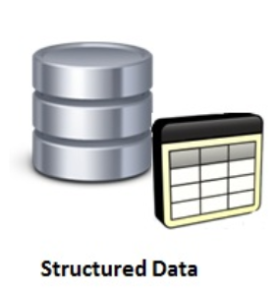
Types of Content:
Structured content:
Structured data is data that has been organized into a formatted repository, typically a database, so that its elements can be made addressable for more effective processing and analysis.
Structured content is content that is planned, developed and connected outside of an interface so it’s ready for any interface.
It treats content as data, so it makes sense to people and computers.
Example: Data base

Slide 15
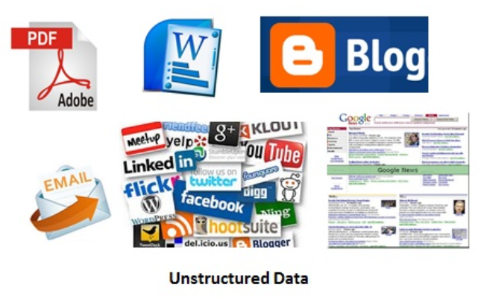
Types of Content:
Unstructured content:
Unstructured content refers to information that either does not have a pre-defined data model or is not organized in a pre-defined manner.
Unstructured information is typically text-heavy, but may contain data such as dates, numbers, and facts as well.
Example : Emails, web content

Slide 16
Structured data Vs. Unstructured data
 | Structured Data | Unstructured Data
Characteristics | Pre – defined data models Usually text only Easy to search | No pre – defined data model May be text, images, sound, video or other formats Difficult to search
Resides in | Relational databases Data warehouses | Applications No SQL databases Data warehouses Data lakes
Generated by | Humans or machines | Humans or machines

Slide 17
Structured data Vs. Unstructured data
 | Structured Data | Unstructured Data
Typical applications | Airline reservation systems Inventory control CRM systems ERP systems | Word processing Presentation software Email clients Tools for viewing or editing media
Examples | Dates Phone numbers Social security numbers Credit card numbers Customer names Addresses Product names and numbers Transaction information | Test files Reports Email messages Audio files Video files Images Surveillance imagery

Slide 18
What is Metadata?
Each content item is associated with some structured data,
which describes the content item. This data that provides information about the attached content item is called metadata.
Metadata consists of a set of data items called properties or attributes.
Content management systems utilize metadata extensively to provide sophisticated functionality.
For example, metadata is essential for making documents searchable in terms of their author, title, subject, or keywords.

Slide 19
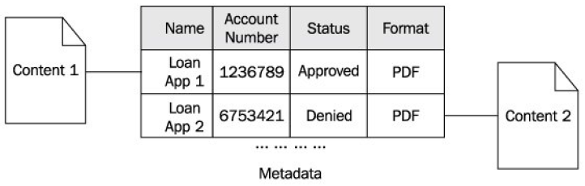
What is Metadata?
The figure below shows two content items and their associated metadata:
The content file content1 contains:
Name : Loan App 1
Account Number: 1236789
Status: Approved
The content file content2 contains:
Name : Loan App 2
Account Number: 6753421
Status: Approved
The content files represent two loan applications in PDF format.

Slide 20
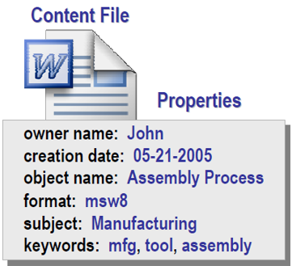
What are properties?
Properties are information that describes a content file.
Property information is not part of the content file but is associated with the content file and stored separately.
Properties are used to describe all objects in the repository and is used for searching and organizing information.

Slide 21
What are properties?
Property values can be assigned in a variety of ways:
Automatically by the content server
Automatically by a client application
Manually by a user
Programmatically through customization
Benefits of Properties:
Faster and more accurate searches for objects in the repository.
Improved organization and management of documents in the repository.
Enables automation on documents based on property settings.

Slide 22
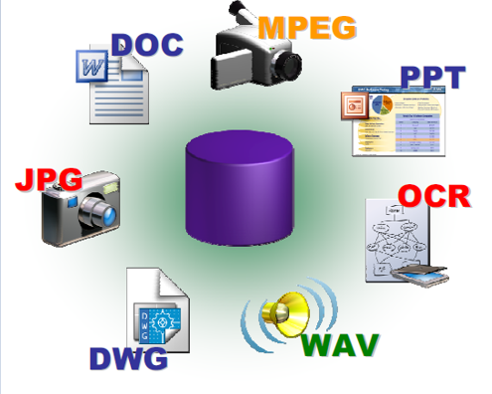
File Formats
Content files in the repository can be of any format.
Content files can be created with any application.
When a document is accessed, the appropriate viewing or editing application is automatically launched on the client computer.

Slide 23
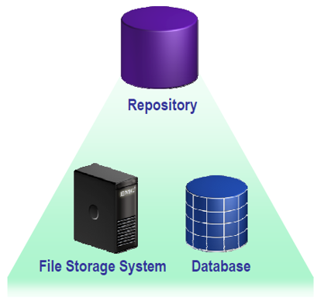
Documentum Repository
A repository is a managed unit of content and metadata storage and includes areas on the file system and a database.
The repository is managed and made available to the users and applications via standard interfaces by a Content Server process.
Documentum’s Repository:
Stores content on a file storage system
Stores properties in a Relational Database Management System (RDBMS)
Oracle, SQL Server, DB2, Sybase
Supports multiple operating systems
UNIX, Linux, Windows

Slide 24
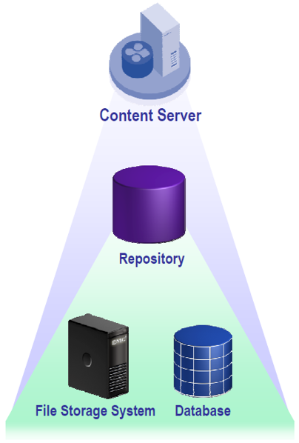
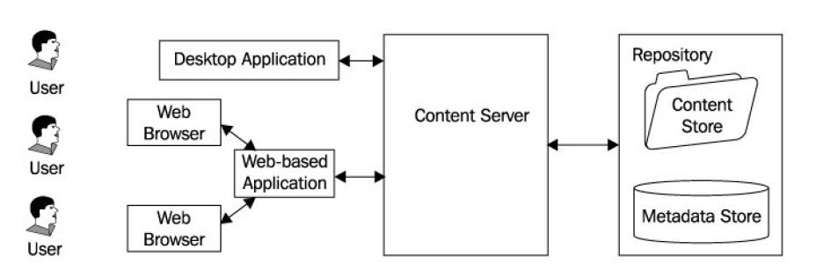
The Content Server
Content server is a service that manages the repository
The Repository can only be accessed via the content server
Supports client-server and web-based applications.
Content Server provides an Application
Programming Interface (API) and therefore
needs applications in front of it to expose a
friendly interface to human users.

Slide 25

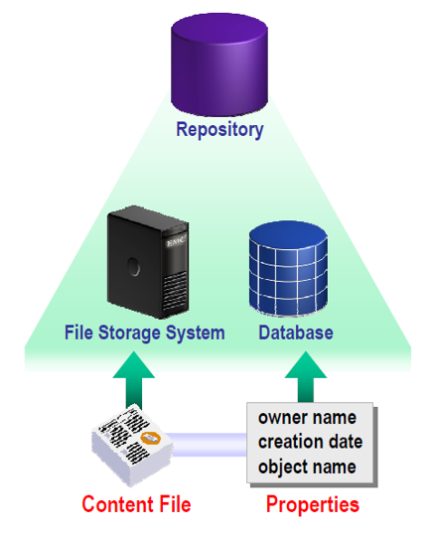
Repository Objects
Content is stored in a repository as an object.
An object is made out of two elements:
Properties : Stored in the database
Content File (Optional): Stored on the File system.
Documentum uses an object-oriented model to
store information within the repository.
Everything stored in the repository participates
in this object model in some way.
For example: a user, a document, and a folder
are all represented as objects.

Slide 26
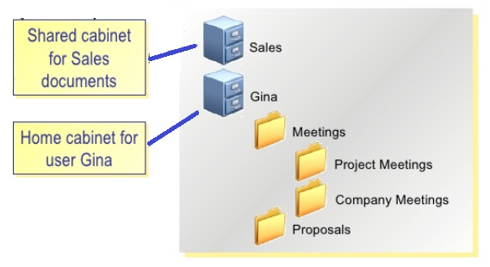
Cabinets and Folders
Cabinet:
A cabinet is the highest level of organization for a repository. It can contain folders and content.

Slide 27
Cabinets and Folders
Folder:
A folder is the next level of organization below a cabinet.
It can contain folders and content.
Unlike a physical folder with a paper document, content can be seen from more than one cabinet/folder, and a single folder can be seen from more than one cabinet/folder.
Content in a repository is displayed using cabinet/folder hierarchy
Actual location of content on the server is transparent to users.
Each user is assigned to a home cabinet or folder.
Shared cabinet or folder also exist in a repository.

Slide 28
Standard services provided by content server
Content Server is the foundation of the Documentum platform and provides the following standard services:
Content management services:
Content management services primarily deal with storage and retrieval, versioning, data dictionary, assembly and publishing, and search functionality.
Process management services:
Process management features include workflows and lifecycles.
Security services:
Security features include security for content and metadata and accountability for operations.
Distributed services:
A Documentum installation can include multiple repositories and Content Server supports various distributed models, including single repository and multi-repository models.

Slide 29
Any type of electronic data that can be managed by a repository is called :
Content
Metadata
Both a and b
None of the above
Answer: a

Slide 30
Metadata consists of a set of data items called
a) Properties
Attributes
Content
Both a or b
Both a or c
Answer: d

Slide 31
True or False
Statement : Content Server Serves content to applications ,which provide friendly interfaces to human users
Answer: True

Slide 32
Summary
Files stored on the file system are generally unstructured and can contain information in any form. Such files and information they contain are collectively referred to as Content.
Each content item is associated with some structured data, which describes the content item, this data that provides information about the attached content item is called metadata.
Properties are information that describes a content file.
A Repository is a managed unit of content and metadata storage and includes areas on the file system and a database.
Content Server Serves content to applications ,which provide friendly interfaces to human users.

Slide 33
Library Function and Versioning

Slide 34
Library Function
Checking Out
A repository has multiple users and it is possible that two users may try to access the same document at one time. It is not a problem if they are just trying to view the document or to export a copy of the document. However, it becomes a problem if they both try to edit the document.
Who gets to edit the document? Whose changes will supersede if they are both allowed to edit the document? Fortunately, this problem is not unique to Documentum, or even to the content management discipline. In its general form, this concern is known as concurrency control.
Documentum uses a simple approach to resolve this problem—exclusive access for modification.
A user must check out a document from the repository before he/she can make changes to it. This operation locks the document in the repository, preventing other users from checking it out and modifying it.

Slide 35
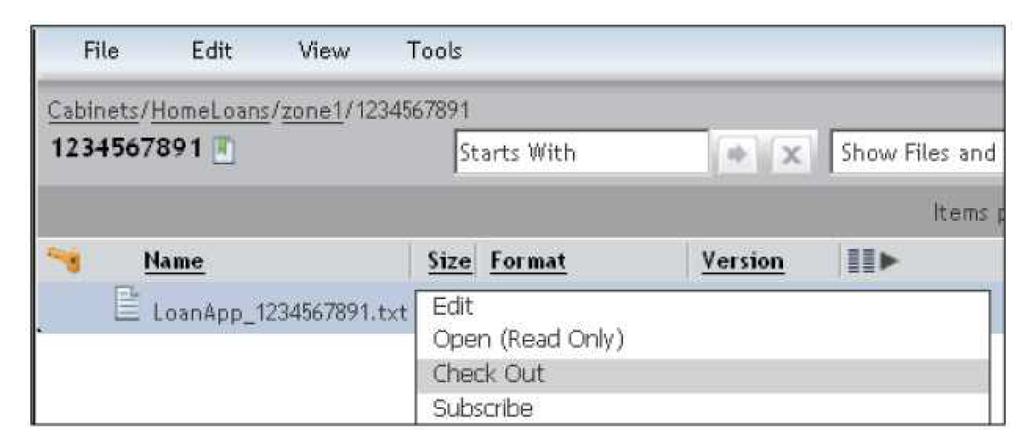
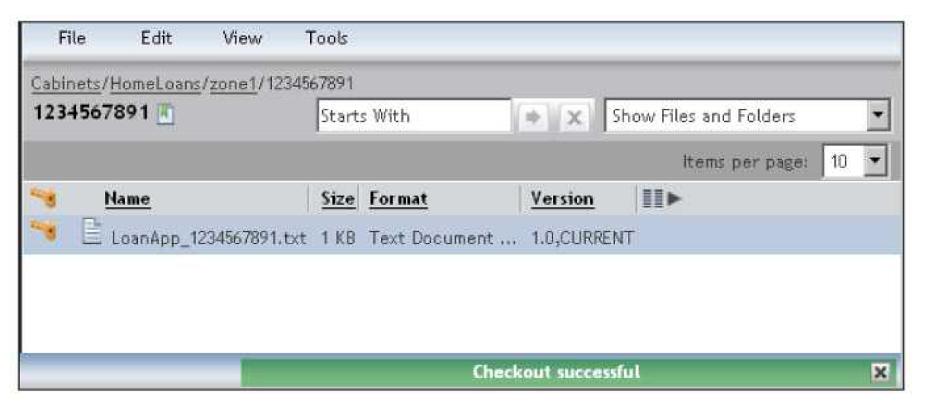
Library Function
Checking Out
The user checking out the document is known as the lock owner for that document. Other users can still access the locked document or any of its existing versions for viewing or exporting.

Slide 36
Library Function
Checking In
The primary purpose of checking out a document is to modify its content and then check in the modified content.
The user modifying the content can take a long time before it is ready to be checked back into the repository.
When DA makes a local copy of the content on checkout, it remembers the association of the external copy with the document in the repository that was checked out.
DA utilizes this memory at the time of checking in to locate the modified file.

Slide 37
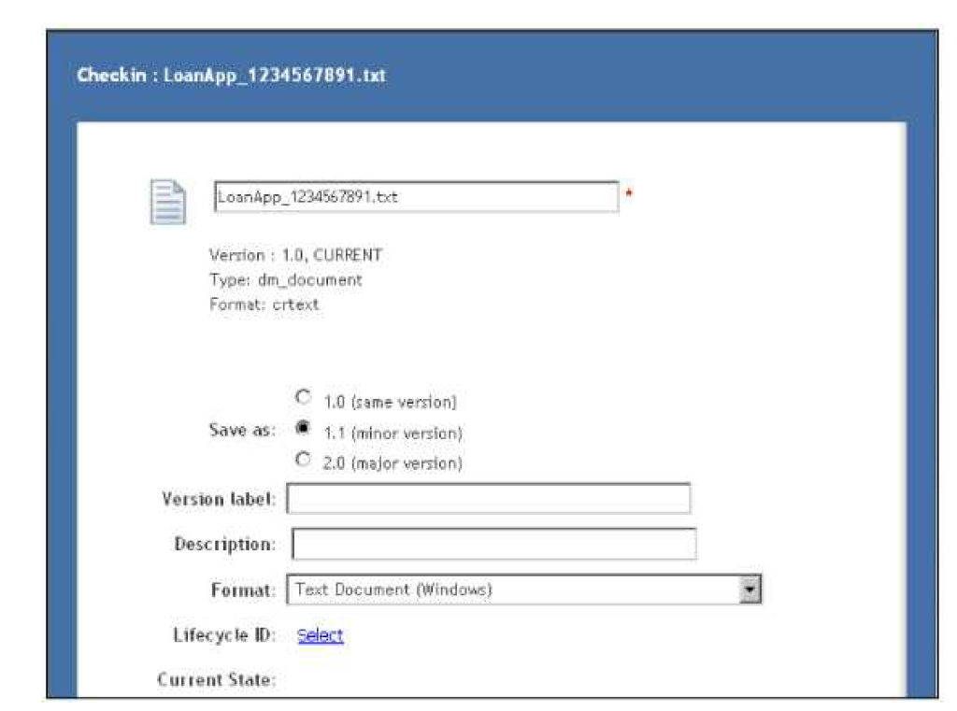
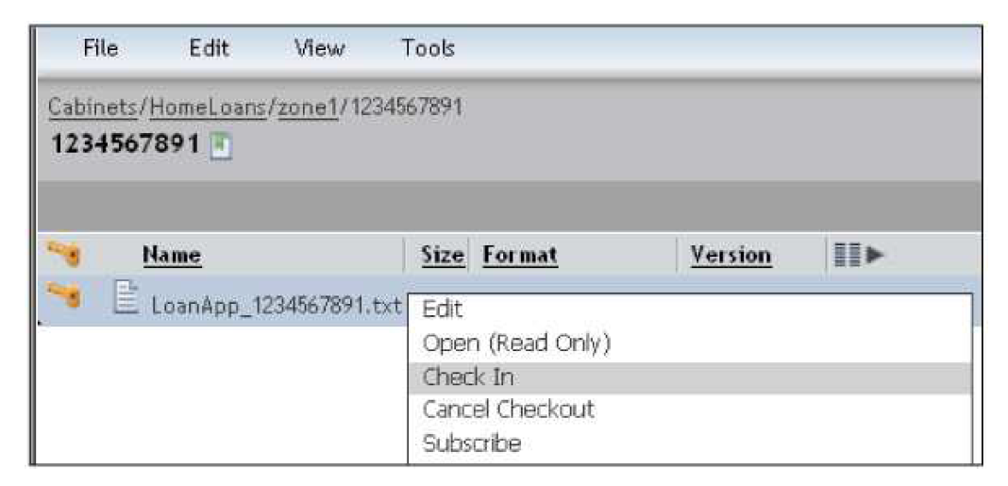
Library Function
Checking In
What happens to the existing content for a document when the modified content is checked in? Is it overwritten? Is a new copy of the document created? The answer could be either, depending on the options specified by the user.

Slide 38
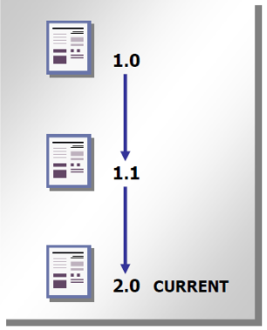
Versioning
Importing or creating a new document assigns version 1.0 to it, by default. Checking out and checking in this document creates a new version of the document, which is a separate document with its own content and metadata. Repeating this process, several versions can be derived from one original document.
Major version
Released: generally made available to all users
Only one version of a document in a given version series
can be in the Released state at a time
Minor version
Draft: generally made available to a restricted set of
authors and reviewers
Versioning states
Released: A major version
In Process: A checked in minor version
Reservation: A document whose content is currently being edited
Superseded: A major or minor version that is no longer the most recent version

Slide 39
Draft version of a document in ECM terminology?
Released Document
Superseded Document
Major Version
Minor Version
Published Document
Ans: d

Slide 40
True or False
Statement :
A user must not check out a document from the repository before he/she can make changes to it.
Answer: False

Slide 41
Summary
Library functions provided by Documentum Administration are:
Check-out
Check-in
Importing or creating a new document assigns version 1.0 to it, by default.

Slide 42
Applications for using and managing Documentum platform

Slide 43
Applications for using and managing Documentum platform – Documentum Administrator
Documentum Administration (DA):
DA is the primary web application for Documentum users. It is also the basis for several other Documentum web applications and custom applications developed to serve specific needs of organizations.
Logging in
DA is accessed via a web browser using a URL of the form
http://host:port/da
Example:
In the Log in page you need to provide Login Name, Password and select the appropriate Repository from the dropdown.

Slide 44
Applications for using and managing Documentum platform – Documentum Administrator
Graphical User Interface (GUI)
Navigation can be performed using the Browser Tree on the left.
Items can be selected in the Work Area.
Actions can be performed using regular menus in the Menu Bar or the context menu.
The Status Bar at the bottom is used for displaying messages, and a Search bar at the top contains search controls, the Logout button, and the help (?) button.

Slide 45
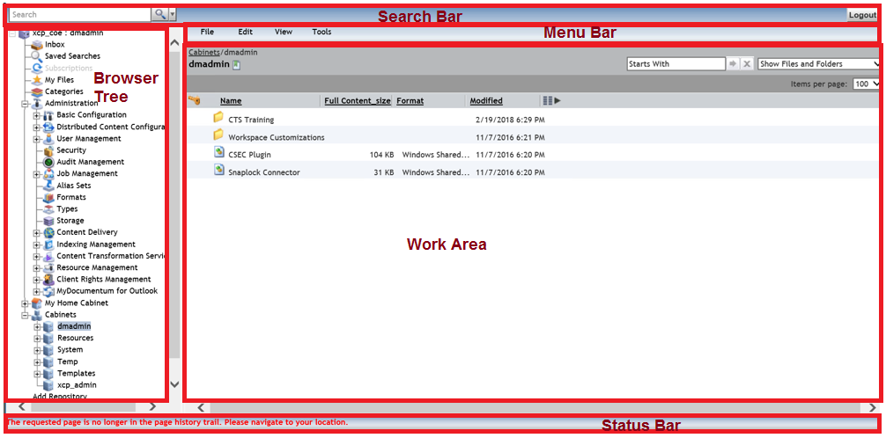
Applications for using and managing Documentum platform – Documentum Administrator
Graphical User Interface (GUI)

Slide 46
Applications for using and managing Documentum platform – Documentum Administrator
Graphical User Interface (GUI) – Browser Tree
The browser tree is used for navigation—locating items within the repository.
Structurally, it looks similar to the folder tree display within Windows Explorer.
The items displayed in the tree are called nodes. Clicking on a node in the browser tree usually updates the work area.
Nodes in the browser tree include:
Inbox
Saved searches
Subscriptions
My Files
Categories
Administration
My Home Cabinet
Cabinets
Add Repository

Slide 47
Applications for using and managing Documentum platform – Documentum Administrator
Graphical User Interface (GUI) – Work Area
The work area displays a list of items with one item per row.
Usually, they are items linked to a folder such as documents and subfolders.
When a search is performed the items displayed in this area are search results.
In general, the items shown in this area depend on the node
Graphical User Interface (GUI) – Menu Bar
There are two kinds of menus available to users for performing actions—menus in the menu bar above the work area and the context menu displayed by right-clicking on a selection of item.
Menus in the menu bar contain actions that the user can perform.
Some actions can only be performed on selected items and become unavailable (grayed out and not clickable) when no items have been selected.

Slide 48
Applications for using and managing Documentum platform – Documentum Administrator
Graphical User Interface (GUI) – Search Bar
The browser tree enables the user to locate items by navigating through folders or looking under specific nodes in the tree. On the other hand, searching enables the user to find items based on their properties or contents.
The items could be present anywhere in the repository and even outside the repository, depending on the installation configuration and search parameters.
Search functionality can be accessed via the bar at the top, which also contains the Logout and help (?) buttons.
Graphical User Interface (GUI) – Status Bar
The Status Bar at the bottom of the GUI is used to display messages, usually when an action has been performed.
It displays both informational and error messages.

Slide 49
Applications for using and managing Documentum platform – D2
Documentum D2 consists of two components:
D2 Configuration:
The web-based application, hereafter known as D2 Config, for administrators to
use to configure settings such as automated content-handling processes and background settings for D2 Client.
D2 Client:
The web-based application for users that provides the ability to interact with content in one or more repositories.
You use D2 Client to configure a user interface that streamlines necessary content management processes.

Slide 50
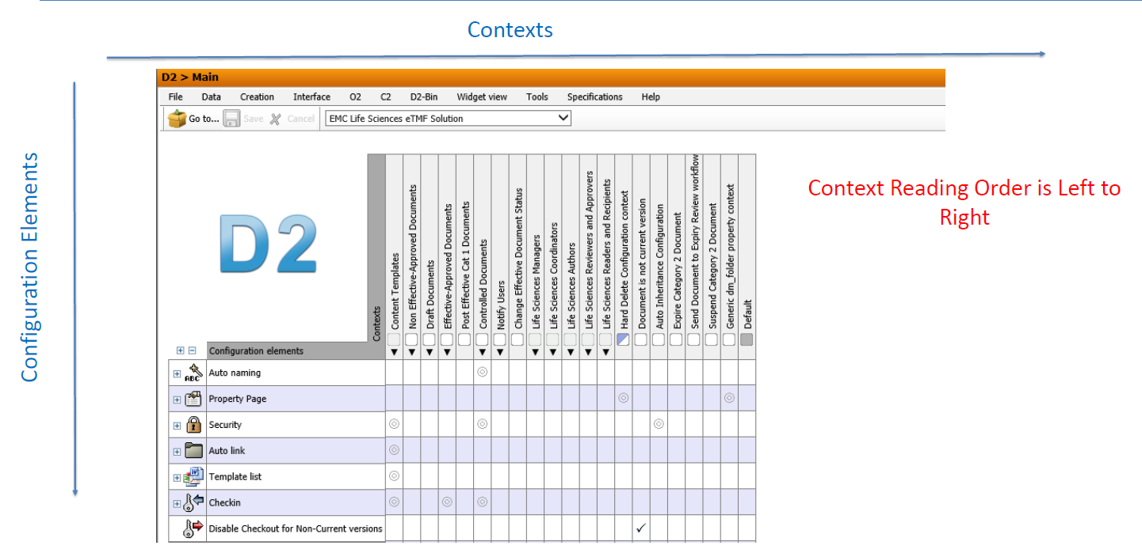
Applications for using and managing Documentum platform – D2
Graphical User Interface (GUI) – D2 Configuration

Slide 51
Which of the following statements is/are true w.r.t D2 configuration:
Context reading order is always from Right to Left
Context reading order is always from Left to Right
Context does not have to be read in any specific order
None of the above
Answer: b

Slide 52
Practice Lab

Slide 53
Practice Lab 1
View Properties of a document.
Login to Documentum Administrator.
In the left side browser tree, go to Cabinets.
Browse the document from Cabinets -> <your_concerned_cabinet> -> <document>.
Once you select the document, right click and go to properties. The properties window will open.
This window consist of 3 tabs namely – Info, Permissions and History.
Check each tab for your reference and understanding.
Alternatively, you can also check properties by using the shortcut key “P”.

Slide 54
Practice Lab 2
View Version of a particular document.
Login to Documentum Administrator.
In the left side browser tree, go to Cabinets.
Browse the document from Cabinets -> <your_concerned_cabinet> -> <document>.
Once you select the document, right click and go to View -> Versions.
This page will describe which document version is it along with the size, format, Modified and Path.
The version of the document is mentioned under Version column. If the document is CURRENT version this would also be mentioned in the Version column.

Slide 55
You have successfully completed
Documentum Fundamentals
Notes:
Place the audio notes for this slide here

